Slide 1
Introduction to Java

Slide 2
Data Type
Data type defines the values that a variable can take, for example if a variable has int data type, it can only take integer values. In java we have two categories of data type:
1) Primitive data types 2) Non-primitive data types – Arrays and Strings are non-primitive data types,

Slide 3
Primitive Data types
In Java, we have eight primitive data types: boolean, char, byte, short, int, long, float and double. Java developers included these data types to maintain the portability of java as the size of these primitive data types do not change from one operating system to another.
byte, short, int and long data types are used for storing whole numbers.
float and double are used for fractional numbers.
char is used for storing characters(letters).
boolean data type is used for variables that holds either true or false.

Slide 4
Byte
This can hold whole number between -128 and 127. Mostly used to save memory and when you are certain that the numbers would be in the limit specified by byte data type.
Default size of this data type: 1 byte.
Default value: 0
Example:
class JavaExample
{
public static void main(String[] args)
{
byte num; num = 113;
System.out.println(num);
}
}
Output : 113

Slide 5
Short
This is greater than byte in terms of size and less than integer. Its range is -32,768 to 32767.
Default size of this data type: 2 byte
short num = 45678;

Slide 6
Int
Used when short is not large enough to hold the number, it has a wider range: -2,147,483,648 to 2,147,483,647
Default size: 4 byte
Default value: 0
Example:
class JavaExample
{
public static void main(String[] args)
{
short num; num = 150; System.out.println(num);
}
}
Output : 150

Slide 7
Long
Used when int is not large enough to hold the value, it has wider range than int data type, ranging from -9,223,372,036,854,775,808 to 9,223,372,036,854,775,807.
size: 8 bytes
Default value: 0
Example:
class JavaExample
{
public static void main(String[] args)
{
long num = -12332252626L;
System.out.println(num);
}
}
Output: -12332252626

Slide 8
Double
Sufficient for holding 15 decimal digits
size: 8 bytes
Example:
class JavaExample
{
public static void main(String[] args)
{
double num = -42937737.9d; System.out.println(num);
}
}
Output: -4.29377379E7

Slide 9
Float
Sufficient for holding 6 to 7 decimal digits
size: 4 bytes
class JavaExample
{
public static void main(String[] args)
{
float num = 19.98f; System.out.println(num);
}
}
Output: 19.98

Slide 10
Boolean
holds either true of false.
class JavaExample
{
public static void main(String[] args)
{
boolean b = false;
System.out.println(b);
}
}
Output: false

Slide 11
Char
holds characters.
size: 2 bytes
class JavaExample
{
public static void main(String[] args)
{
char ch = 'Z';
System.out.println(ch);
}
}
Output: Z

Slide 12
Character Set
The character set is a set of alphabets, letters and some special characters that are valid in Java language.
The smallest unit of Java language is the characters need to write java tokens.
These character set are defined by Unicode character set.
Whenever we write any Java program then it consists of different statements. Each Java Program is set of statements and each statement is set of different Java programming lexemes. In Java Programming each and every character is considered as a single lexeme. i.e Basic Lexical Element.

Slide 13
Character Set Consists Of
Alphabets
C and Java accepts both lowercase and uppercase alphabets as variables and functions.
Uppercase: A B C ................................... X Y Z Lowercase: a b c ...................................... x y z
Digits
0 1 2 3 4 5 6 7 8 9
Special Characters
+ _ ( ) { } [ ] \ | / > < ; etc.

Slide 14
Unicode Character System
Unicode is a universal international standard character encoding that is capable of representing most of the world's written languages.
The Unicode standard uses hexadecimal to express a character. For example, the value 0x0041 represents the Latin character A. The Unicode standard was initially designed using 16 bits to encode characters because the primary machines were 16-bit PCs.
Java was created around the time when the Unicode standard had values defined for a much smaller set of characters. Back then, it was felt that 16-bits would be more than enough to encode all the characters that would ever be needed. With that in mind Java was designed to use UTF-16.

Slide 15
Wrapper Classes in Java
A Wrapper class is a class whose object wraps or contains a primitive data types. When we create an object to a wrapper class, it contains a field and in this field, we can store a primitive data types. In other words, we can wrap a primitive value into a wrapper class object.
Need of Wrapper Classes
They convert primitive data types into objects. Objects are needed if we wish to modify the arguments passed into a method (because primitive types are passed by value).
The classes in java.util package handles only objects and hence wrapper classes help in this case also.
Data structures in the Collection framework, such as ArrayList and Vector, store only objects (reference types) and not primitive types.
An object is needed to support synchronization in multithreading

Slide 16
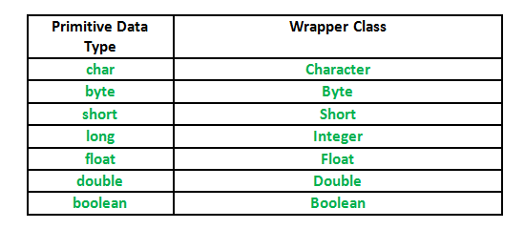
Primitive Data types and their Corresponding Wrapper class

Slide 17
Autoboxing
Autoboxing: Automatic conversion of primitive types to the object of their corresponding wrapper classes is known as autoboxing. For example – conversion of int to Integer, long to Long, double to Double etc.

Slide 18
Example:Java program to demonstrate Autoboxing
import java.util.ArrayList;
class Autoboxing
{
public static void main(String[] args)
{
char ch = 'a';;
// Autoboxing- primitive to Character object conversion
Character a = ch;
ArrayList<Integer> arrayList = new ArrayList<Integer>();
// Autoboxing because ArrayList stores only objects
arrayList.add(25);
// printing the values from object
System.out.println(arrayList.get(0));
}
}

Slide 19
Unboxing
Unboxing: It is just the reverse process of autoboxing. Automatically converting an object of a wrapper class to its corresponding primitive type is known as unboxing. For example – conversion of Integer to int, Long to long, Double to double etc.

Slide 20
Java program to demonstrate Unboxing
import java.util.ArrayList;
class Unboxing
{
public static void main(String[] args)
{
Character ch = 'a';
// unboxing - Character object to primitive conversion
char a = ch;
ArrayList<Integer> arrayList = new ArrayList<Integer>();
arrayList.add(24);
// unboxing because get method returns an Integer object
int num = arrayList.get(0);
// printing the values from primitive data types
System.out.println(num);
}
}

Slide 21
Type Casting
Type Casting
Assigning a value of one type to a variable of another type is known as Type Casting.
Example :
int x = 10;
byte y = (byte)x;
In Java, type casting is classified into two types,
Widening Casting(Implicit)
Narrowing Casting(Explicitly done)

Slide 22
Widening or Automatic type converion
Automatic Type casting take place when,
the two types are compatible
the target type is larger than the source type
public class Test
{
public static void main(String[] args)
{
int i = 100;
long l = i; //no explicit type casting required
float f = l; //no explicit type casting required System.out.println("Int value "+i); System.out.println("Long value "+l); System.out.println("Float value "+f);
}
}

Slide 23
Narrowing or Explicit type conversion
When you are assigning a larger type value to a variable of smaller type, then you need to perform explicit type casting.
Example :
public class Test
{
public static void main(String[] args)
{
double d = 100.04;
long l = (long)d; //explicit type casting required
int i = (int)l; //explicit type casting required System.out.println("Double value "+d); System.out.println("Long value "+l); System.out.println("Int value "+i);
}
}

Slide 24
Java Comments
The java comments are statements that are not executed by the compiler and interpreter. The comments can be used to provide information or explanation about the variable, method, class or any statement. It can also be used to hide program code for specific time.

Slide 25
Types of Java Comments
There are 2 types of comments in java.
Single Line Comment
Multi Line Comment

Slide 26
Java Single Line Comment
The single line comment is used to comment only one line.
Syntax:
//This is single line comment
Example:
public class CommentExample1 {
public static void main(String[] args) {
int i=10;//Here, i is a variable
System.out.println(i);
}
}

Slide 27
Java Multi Line Comment
The multi line comment is used to comment multiple lines of code.
Syntax:
/*
This
is
multi line
comment
*/
Example:
public class CommentExample2 {
public static void main(String[] args) {
/* Let's declare and
print variable in java. */
int i=10;
System.out.println(i);
}
}

Slide 28
Java Reserved Words
Java reserved words are keywords that are reserved by Java functions or other uses that cannot be used as identifiers (e.g., variable names, function names, class names). If a reserved word was used as a variable you would get an error or unexpected result.
List of Java reserved words
abstract, assert, boolean, break, byte, case
catch, char, class, const, default

Slide 29
Java Identifiers
In programming languages, identifiers are used for identification purpose. In Java an identifier can be a class name, method name, variable name or a label.
For example :
public class Test
{
public static void main(String[] args)
{
int a = 20;
}
}

Slide 30
In the above java code, we have 5 identifiers namely :
Test : class name.
main : method name.
String : predefined class name.
args : variable name.
a : variable name.

Slide 31
Rules for defining Java Identifiers
There are certain rules for defining a valid java identifiers. These rules must be followed, otherwise we get compile-time error. These rules are also valid for other languages like C,C++.
The only allowed characters for identifiers are all alphanumeric characters([A-Z],[a-z],[0-9]), ‘$‘(dollar sign) and ‘_‘ (underscore).For example “geek@” is not a valid java identifier as it contain ‘@’ – special character.
Identifiers should not start with digits([0-9]). For example “123geeks” is a not a valid java identifier.
Java identifiers are case-sensitive.
There is no limit on the length of the identifier but it is advisable to use an optimum length of 4 – 15 letters only.
Reserved Words can’t be used as an identifier. For example “int while = 20;” is an invalid statement as while is a reserved word. There are 53 reserved words in Java.

Slide 32
Examples of valid identifiers :
MyVariable
MYVARIABLE
myvariable
x
i
x1
i1 _myvariable
$myvariable
sum_of_array
geeks123

Slide 33
Examples of invalid identifiers :
My Variable // contains a space
123geeks // Begins with a digit
a+c // plus sign is not an alphanumeric character
variable-2 // hyphen is not an alphanumeric character
sum_&_difference // ampersand is not an alphanumeric character

Slide 34
Java Variables
A variable is a container which holds the value while the java program is executed. A variable is assigned with a datatype.
Variable is a name of memory location. There are three types of variables in java: local, instance and static.
There are two types of data types in java: primitive and non-primitive.

Slide 35
Variable
Variable is name of reserved area allocated in memory. In other words, it is a name of memory location. It is a combination of "vary + able" that means its value can be changed.
int data=50;//Here data is variable

Slide 36
Types of Variable
There are three types of variables in java:
local variable
instance variable
static variable

Slide 37
Local Variable
A variable declared inside the body of the method is called local variable. You can use this variable only within that method and the other methods in the class aren't even aware that the variable exists.
A local variable cannot be defined with "static" keyword.

Slide 38
Instance Variable
A variable declared inside the class but outside the body of the method, is called instance variable. It is not declared as static.
It is called instance variable because its value is instance specific and is not shared among instances.

Slide 39
Static variable
A variable which is declared as static is called static variable. It cannot be local. You can create a single copy of static variable and share among all the instances of the class. Memory allocation for static variable happens only once when the class is loaded in the memory.

Slide 40
Example to understand the types of variables in java
class A
{
int data=50;//instance variable
static int m=100;//static variable
void method(){
int n=90;//local variable
}
}//end of class

Slide 41
Scope of Variables In Java
Scope of a variable is the part of the program where the variable is accessible. Like C/C++, in Java, all identifiers are lexically (or statically) scoped, i.e.scope of a variable can determined at compiler time and independent of function call stack.
Java programs are organized in the form of classes. Every class is part of some package. Java scope rules can be covered under following categories.

Slide 42
Member Variables (Class Level Scope)
These variables must be declared inside class (outside any function). They can be directly accessed anywhere in class. Let’s take a look at an example:
public class Test {
// All variables defined directly inside a class
// are member variables
int a;
private String b;
void method1()
{....}
int method2()
{....}
char c;
}

Slide 43
Member Variables (Class Level Scope)
We can declare class variables anywhere in class, but outside methods. Access specified of member variables doesn’t effect scope of them within a class. Member variables can be accessed outside a class with following rules

Slide 44
Local Variables (Method Level Scope)
Variables declared inside a method have method level scope and can’t be accessed outside the method.
public class Test
{
void method1()
{
// Local variable (Method level scope)
int x;
}
}
Note : Local variables don’t exist after method’s execution is over.

Slide 45
Loop Variables (Block Scope)
A variable declared inside pair of brackets “{” and “}” in a method has scope withing the brackets only.
public class Test
{
public static void main(String args[])
{
{
// The variable x has scope within
// brackets
int x = 10;
System.out.println(x);
}
// Uncommenting below line would produce
// error since variable x is out of scope.
// System.out.println(x);
}
}

Slide 46
Tokens in Java
Java program is basically a collection of classes. But it have a basic bulding blocks, these basic buildings blocks in Java language which are constructed together to write a java program. This basic bulding blocks are called Token.
Each and every smallest individual units in a Java program are known as C tokens
Simply we can say that java program is also collection of tokens, comments and whitespaces.
In Java Programming tokens are of six types.

Slide 47
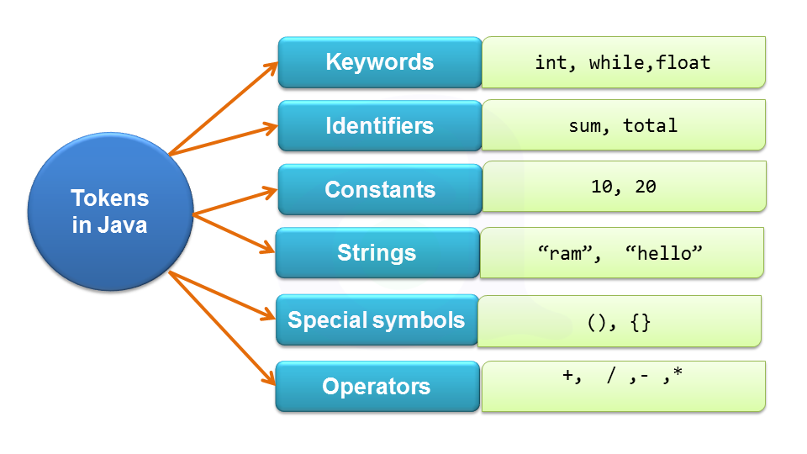
Tokens in Java

Slide 48
Operators in java
Operator in java is a symbol that is used to perform operations. For example: +, -, *, / etc.
There are many types of operators in java which are given below:
Unary Operator,
Arithmetic Operator,
Shift Operator,
Relational Operator,
Bitwise Operator,
Logical Operator,
Ternary Operator and
Assignment Operator.

Slide 49
Java Unary Operator
The Java unary operators require only one operand. Unary operators are used to perform various operations i.e.:
incrementing/decrementing a value by one
negating an expression
inverting the value of a boolean

Slide 50
Java Unary Operator
Example: ++ and --
class OperatorExample
{
public static void main(String args[])
{
int x=10;
System.out.println(x++);//10 (11)
System.out.println(++x);//12
System.out.println(x--);//12 (11)
System.out.println(--x);//10
}
}

Slide 51
Java Arithmetic Operators
Java arithmatic operators are used to perform addition, subtraction, multiplication, and division. They act as basic mathematical operations.

Slide 52
Java Arithmetic Operator Example
class OperatorExample{
public static void main(String args[]){
int a=10;
int b=5;
System.out.println(a+b);//15
System.out.println(a-b);//5
System.out.println(a*b);//50
System.out.println(a/b);//2
System.out.println(a%b);//0
}}

Slide 53
Java Left Shift Operator
The Java left shift operator << is used to shift all of the bits in a value to the left side of a specified number of times.
class OperatorExample
{
public static void main(String args[]){
System.out.println(10<<2);//10*2^2=10*4=40
System.out.println(10<<3);//10*2^3=10*8=80
System.out.println(20<<2);//20*2^2=20*4=80
System.out.println(15<<4);//15*2^4=15*16=240
}
}

Slide 54
Java Right Shift Operator
The Java right shift operator >> is used to move left operands value to right by the number of bits specified by the right operand.
class OperatorExample
{
public static void main(String args[]){
System.out.println(10>>2);//10/2^2=10/4=2
System.out.println(20>>2);//20/2^2=20/4=5
System.out.println(20>>3);//20/2^3=20/8=2
}
}

Slide 55
Java AND Operator
Example: Logical && and Bitwise &
The logical && operator doesn't check second condition if first condition is false. It checks second condition only if first one is true.
The bitwise & operator always checks both conditions whether first condition is true or false.

Slide 56
Example: Logical && and Bitwise &
class OperatorExample{
public static void main(String args[])
{
int a=10;
int b=5;
int c=20;
System.out.println(a<b&&a<c);//false && true = false
System.out.println(a<b&a<c);//false & true = false
}
}

Slide 57
Java OR Operator
Example: Logical || and Bitwise |
The logical || operator doesn't check second condition if first condition is true. It checks second condition only if first one is false.
The bitwise | operator always checks both conditions whether first condition is true or false.

Slide 58
Example: Logical || and Bitwise |
class OperatorExample{
public static void main(String args[]){
int a=10;
int b=5;
int c=20;
System.out.println(a>b||a<c);//true || true = true
System.out.println(a>b|a<c);//true | true = true
//|| vs |
System.out.println(a>b||a++<c);//true || true = true
System.out.println(a);//10 because second condition is not checked
System.out.println(a>b|a++<c);//true | true = true
System.out.println(a);//11 because second condition is checked
}}

Slide 59
Java Ternary Operator
Java Ternary operator is used as one liner replacement for if-then-else statement and used a lot in java programming. it is the only conditional operator which takes three operands.

Slide 60
Java Ternary Operator
class OperatorExample
{
public static void main(String args[])
{
int a=2;
int b=5;
int min=(a<b)?a:b;
System.out.println(min);
}
}

Slide 61
Java Assignment Operator
Java assignment operator is one of the most common operator. It is used to assign the value on its right to the operand on its left.
class OperatorExample
{
public static void main(String args[])
{
int a=10;
int b=20;
a+=4;//a=a+4 (a=10+4)
b-=4;//b=b-4 (b=20-4)
System.out.println(a);
System.out.println(b);
}
}

Slide 62
Operator Precedence in Java
Java has well-defined rules for specifying the order in which the operators in an expression are evaluated when the expression has several operators. For example, multiplication and division have a higher precedence than addition and subtraction. Precedence rules can be overridden by explicit parentheses.

Slide 63
Operator Precedence in Java
Precedence order.
When two operators share an operand the operator with the higher precedence goes first. For example, 1 + 2 * 3 is treated as 1 + (2 * 3), whereas 1 * 2 + 3 is treated as (1 * 2) + 3 since multiplication has a higher precedence than addition.
Associativity.
When an expression has two operators with the same precedence, the expression is evaluated according to its associativity. For example x = y = z = 17 is treated as x = (y = (z = 17)), leaving all three variables with the value 17, since the = operator has right-to-left associativity (and an assignment statement evaluates to the value on the right hand side). On the other hand, 72 / 2 / 3 is treated as (72 / 2) / 3 since the / operator has left-to-right associativity. Some operators are not associative: for example, the expressions (x <= y <= z) and x++-- are invalid.
Precedence and associativity of Java operators.
The table below shows all Java operators from highest to lowest precedence, along with their associativity. Most programmers do not memorize them all, and even those that do still use parentheses for clarity.

Slide 64
Quiz
1) What is the size of int variable?
A - 8 bit
B - 16 bit
C - 32 bit
D - 64 bit

Slide 65
2) What is instance variable?
A - Instance variables are static variables within a class but outside any method.
B - Instance variables are variables defined inside methods, constructors or blocks.
C - Instance variables are variables within a class but outside any method.
D - None of the above.

Slide 66
3) An expression involving byte, int, and literal numbers is promoted to which of these?
A. int
B. long
C. byte
D. float

Slide 67
4) Which of these coding types is used for data type characters in Java?
A. ASCII
B. ISO-LATIN-1
C. UNICODE
D. None of the mentioned

Slide 68
5) Which of these values can a boolean variable contain?
A. True & False
B. 0 & 1
C. Any integer value.
D. Both a & b

